Slide 1

Air &Noise Pollution Monitoring using Raspberry Pi Pico
IoT LAB (EC2601-1)
Submitted by
Sampath NNM23EC153

Slide 2
Contents
Introduction
Literature Review
Methodology
Hardware and Software Requirements
Results and Discussions
Conclusion
References

Slide 3
Introduction
Rapid urbanization and industrial growth have increased air and noise pollution in cities. Harmful gases like VOCs and CO₂ can cause respiratory and heart-related diseases, while excessive noise leads to stress and hearing problems. Traditional monitoring systems are costly, bulky, and provide limited coverage. IoT-based monitoring systems offer a low-cost and scalable solution for real-time environmental monitoring. Microcontrollers such as the Raspberry Pi Pico W enable continuous data collection with low power consumption. Cloud platforms like ThingSpeak help in data visualization, storage, and environmental analysis.

Slide 4
Literature Review
Traditional environmental monitoring systems are costly and have limited coverage.
Raspberry Pi Pico enable low-cost real-time IoT monitoring.
MQTT and ThingSpeak support efficient cloud data transmission and visualization.
Enables telegram bot alert message when Threshold reached.
This project combines both air quality and noise monitoring in a single IoT-based system.

Slide 5
Methodology
The MQ135 Gas Sensor detects harmful gases like VOCs and CO₂, while the sound sensor measures ambient noise levels.
The Raspberry Pi Pico W collects analog sensor data using its 12-bit ADC and converts it into digital values.
MicroPython firmware processes the sensor readings and converts them into air quality and noise level values.
The processed data is transmitted to the cloud using MQTT through the Pico W’s built-in Wi-Fi module.
ThingSpeak stores, visualizes, and generates alerts when pollution levels exceed safe limits.

Slide 6
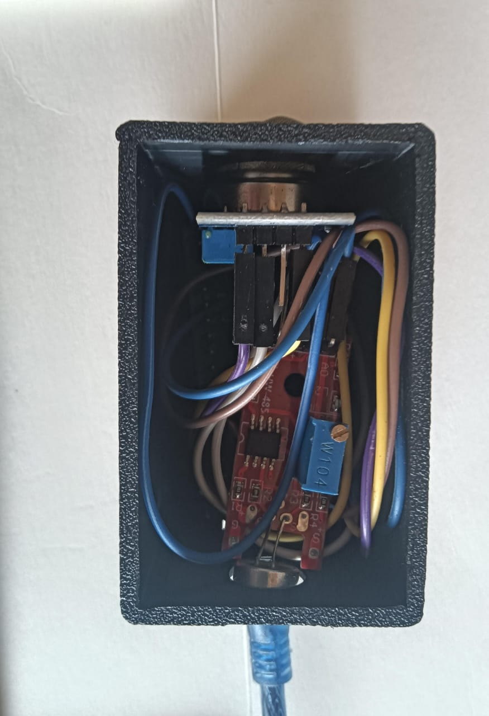
Hardware Requirements
Hardware Requirements:
Raspberry Pi Pico— Central Microcontroller Unit
MQ135 Gas Sensor — Air Quality and VOC detection
Sound Sensor Module — Ambient Noise Level measurement
Micro-USB Cable — For powering and programming the Pico
Connecting Wires— For circuit connections

Slide 7
Software Requirements
Software Requirements:
Thonny IDE —For writing and uploading MicroPython code
MQTTProtocol — For lightweight data transmission to cloud
ThingSpeak Cloud Platform — For data storage, visualization and monitoring

Slide 8
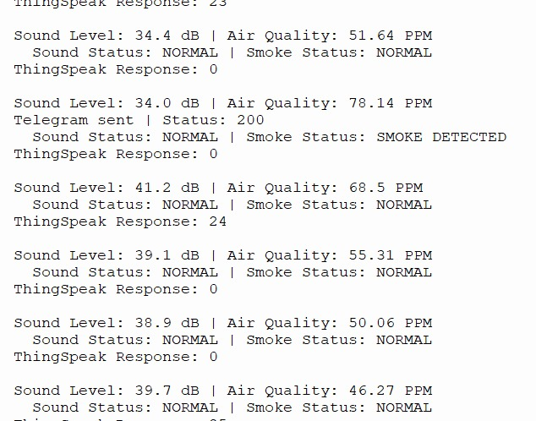
Results and Discussion
Serial Monitor Output

Slide 9
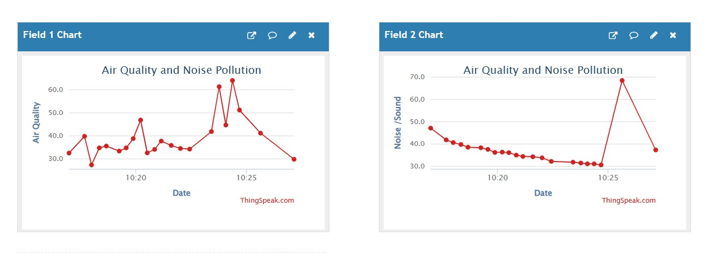
Results and Discussion
ThingSpeak Charts
Two real-time charts are displayed on the ThingSpeak dashboard under the channel "Air Quality and Noise Pollution."

Slide 10
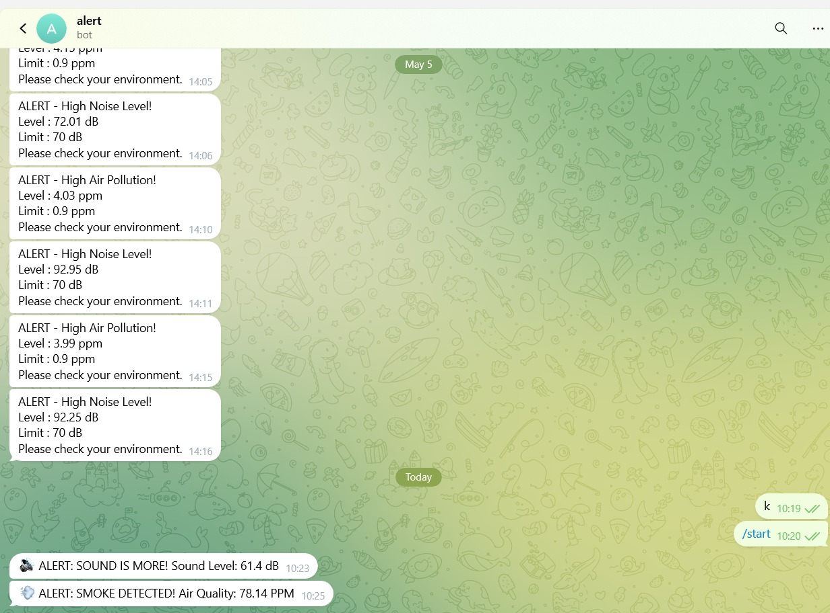
Results and Discussion
Telegram Bot Alerts
The Telegram chat with the bot named "alert" shows a history of notifications. On the current day, the bot received alerts: "ALERT: SOUND IS MORE! Sound Level: 61.4 dB" at 10:23 and "ALERT: SMOKE DETECTED! Air Quality: 78.14 PPM

Slide 11
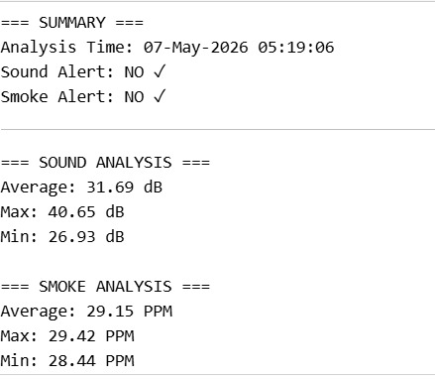
Results and Discussion
Summary of Analysis
The MATLAB analysis , Both Sound Alert and Smoke Alert are marked NO ✓, confirming safe conditions during that session. Sound averaged 31.69 dB (min: 26.93, max: 40.65) and smoke averaged 29.15 PPM (min: 28.44, max: 29.42)

Slide 12
Conclusion
The Air and Noise Pollution Monitoring System was successfully developed using the Raspberry Pi Pico W with MQ135 gas and sound sensors for real-time environmental monitoring. The system continuously measured air quality and noise levels and transmitted the data to ThingSpeak using MQTT over Wi-Fi for visualization and alert generation. The system proved to be low-cost, reliable, and suitable for smart city and industrial monitoring applications. Future improvements can include additional sensors, GPS-based pollution mapping, and AI-based pollution prediction.

Slide 13
References
[1] Raspberry Pi Foundation, ”Raspberry Pi Pico W Datasheet,” Raspberry Cambridge, UK, Published: June 2022. Available: https://www.raspberrypi.com/documentation/microcontrollers/raspberry-pi-pico.html
[2] MathWorks, ”ThingSpeak IoT Analytics Platform Documentation,” MathWorks Inc., Natick, MA, USA, Published: January 2023.
[3] OASIS Standard, ”MQTT Version 3.1.1 Protocol Specification,” OASIS Open, Published: October 2014.

Slide 14
Thank You

